Slide 1
LSCVAMC Clinical Research Center
Margaret Tiktin, DNP, CNP, MBA
Clinical Research Center Director

Slide 2
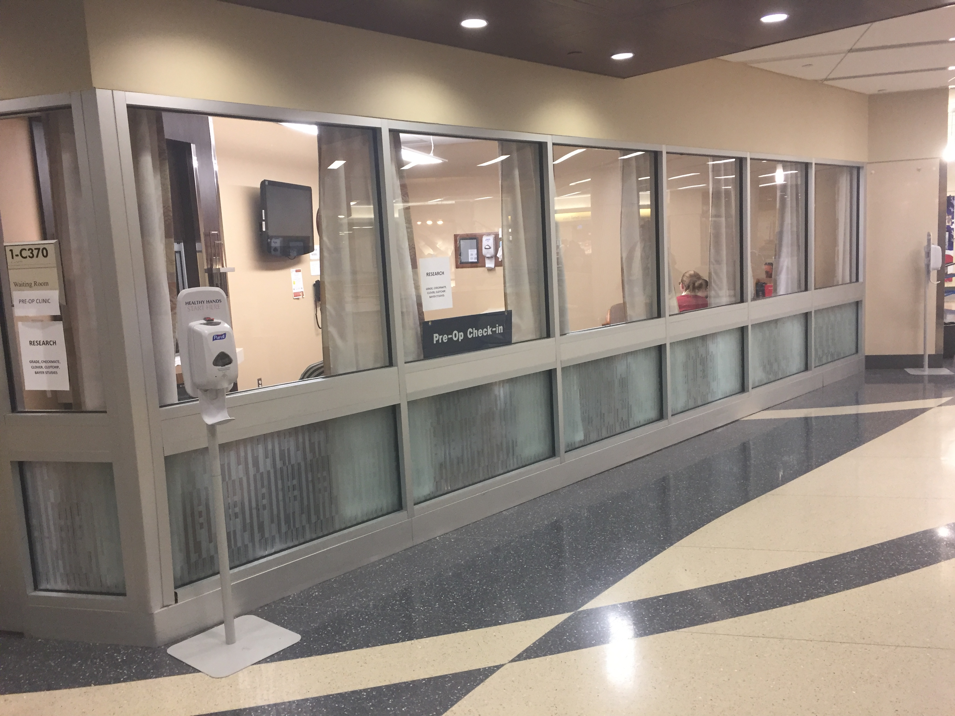
Clinical Research Center
Centralized location for resources and expertise to support investigators and research staff to promote efficient, innovative, and compliant clinical trails.

Slide 3
Goals of Center
Supports-new methods and approaches to clinical and translational research
Improve institutional procedures
Provide new treatments more efficiently and quickly to patients
Assemble interdisciplinary teams

Slide 4
Clinical Research Center
Opened in 2017
4,000 square foot facility
Includes
Exam rooms
Consult rooms
Phlebotomy area
Specimen processing and storage
Secure file storage
Reception area
Offices for study coordinators

Slide 5
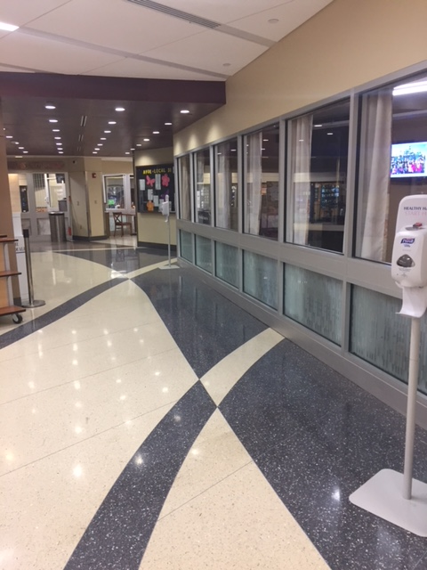
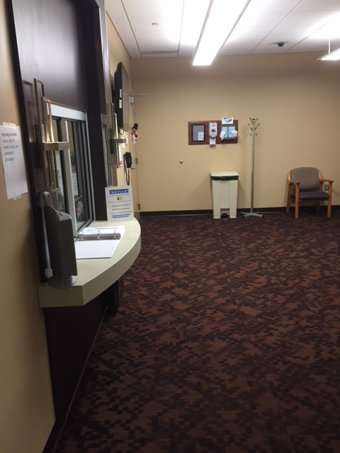
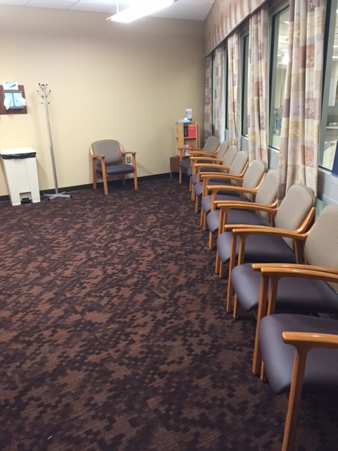
Located across from the Cafeteria
Reception Area

Slide 6
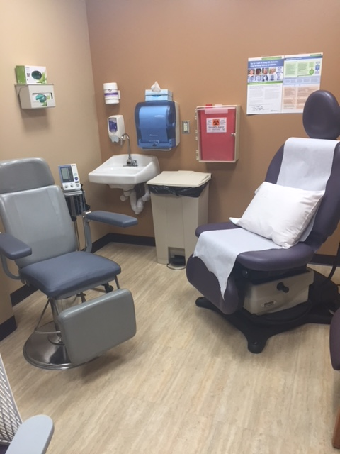
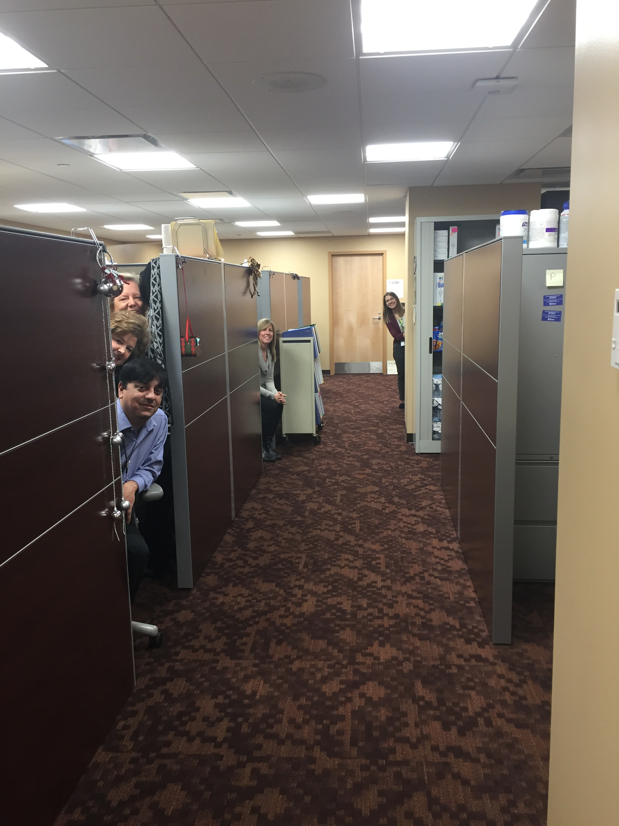
Exam Room
Coordinator Office Space

Slide 7
Research in the CRC
Currently 24 studies
19 managed by the Research and Education Foundation
5 managed by VA Research office
Represented Areas of Research
Cardiology/Hematology (8)
Infectious Disease (3)
Diabetes (3)
Patient Care (2)
Oncology (5)
Urology (1)
Stroke Rehabilitation (1)
Mental Health (1)

Slide 8
Selection of Current Projects in CRC
VA Research-Foundation
CLOVER (Donskey) “A Phase 3, placebo-controlled, randomized, observer-blinded study to evaluate the efficacy, safety and tolerability of a Clostridium difficle vaccine in adults 50 years of age and older”
EMPORER (Moghbelli) “A phase III randomized, double blind trial to evaluate efficacy and safety of once daily empagliflozin 10mg compared to placebo, in patients with chronic Heart Failure with preserved Ejection Fraction (HFpEF)”
ClotChip (Stavrou) “Miniaturized Dielectric Coagulometry for Monitoring Anticoagulation (ClotChip and TSOACs)”
INVESTED (Goldberg) “INfluenza Vaccine to Effectively Stop Cardio Thoracic Events and Decompensated Heart Failure (INVESTED)”
Checkmate (Nock) “A Master Protocol of Phase ½ Studies of Nivolumab in Advanced NSCLC Using Nivolumab as Maintenance after Induction Chemotherapy or as First-line Treatment Alone or in Combination with Standard of Care Therapies”
GRADE (Ismail-Beigi) “Glycemic Control and Treatment Satisfaction Using Finesse Versus Pen for initiating Bolus Insulin Dosing in Type 2 Diabetes Mellitus Patients not Achieving Glycemic Targets on Basal Insulin with/without Anti-Hyperglycemic Agent”
TR701-132 (Bonomo) “A Phase 3 Randomized Double-Blind Study Comparing TR-701 FA and Linezolid in Ventilated Gram-positive Nosocomial Pneumonia”
VA Office
opTION CSP (Donskey) “Optimal Treatment f or Recurrent Clostridium difficile Infection”
VA HSR&D PRIME CARE (Chen) “PRecision medicine in MEntal health care”

Slide 9
What We Provide
Extensive Clinical Trial Review
Assess new trials to ensure we have sufficient resources, staff, and suitable population for recruitment
Match investigators with new clinical trial opportunities
Management of Clinical Trial
Evaluation of enrollment
Overlap of study staff
Assistance with start up activities
Clinical Research Coordinators
Highly experienced and dedicated clinical research nurses and coordinators
Cross-trained staff
Dedicated Clinical Trial Space

Slide 10
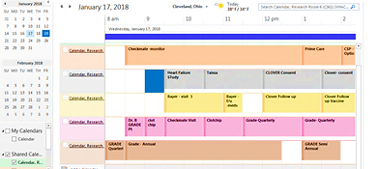
Scheduling and Utilization of CRC Space
Development of a centralized room reservation schedule for clinical trials (currently 5 rooms)
Linda Colosimo point of contact until new coordinator trained

Slide 11
Future Plans/Goals for the CRC
Full time person to perform data pulls
Recruitment Coordinator
Multi-site management
Cross training of staff
Mentoring/training of new staff (formalized)

Slide 12
Cleveland VA Medical Research and Education Foundation (CVAMREF)
Marcie Denallo, MS
Grants and Contracts Administrator

Slide 13
Cleveland VA Medical Research and Education Foundation (CVAMREF)
Our Primary Mission is to Advance the Success of VA Research through the Efficient and Flexible Administration of Grants
Jeffrey Moore, PhD: Executive Director
Margaret Tiktin, DNP, CNP, MBA: Director of Clinical Research Center
Marcie Denallo, MS: Grants and Contracts Administrator
Marian Molnar: Accountant
Manda Double, BS: Clinical Research Support Coordinator
Rebecca Polito, MS: Technical Writer and Communication Specialist

Slide 14
Cleveland VA Medical Research and Education Foundation (CVAMREF)
Manage and track all sponsored projects that are not VA funded
Federal (NIH, DoD, CDC)
Industry (Pfizer, Merck, Novartis)
Foundation
Subcontracts with affiliated institutions
Grants supporting research done at the VA with non-VA funds must be administered in whole or in part through the Foundation
We work with other institutions to set up subcontracts and MOUs
Case Western Reserve University, Cleveland Clinic Foundation, University Hospitals, MetroHealth etc.

Slide 15
Cleveland VA Medical Research and Education Foundation (CVAMREF)
Pre-award Management
Oversee the planning, tracking, and management of grant submissions
Preparing documents, setting up a budget, and submission of grant
Investigate potential funding or award opportunities
Post award Management
Contract negotiation
Provide on-going direction, guidance, support to PI in management of grants and contracts
IRB submission support
Financial support
Submitting amendments/modifications

Slide 16
Cleveland VA Medical Research and Education Foundation (CVAMREF)
Financial Management
Manage project revenues and expenses
Hire staff
Purchase supplies and equipment
Allocation of resources along project timelines
Provide financial reports to funding agencies

Slide 17
Cleveland VA Medical Research and Education Foundation (CVAMREF)
Regulatory Support
Full study submission support from notification of site selection and forward; including submissions, modifications, and annual reviews.
Sponsors required documentation
R&D submission
Sub-committee submission
IRB
Safety
Pharmacy
Radiation
Liaison between PI, study sponsor, contract research organizations (CRO), local clinical team and local IRB to obtain needed approvals.

Slide 18
Who to contact
Type of Funding
VA Funding (CSP, MERIT etc.,)
Non-VA Funding
Research Office
Holly Henry
Clinical Research Center
Margaret Tiktin
Research Foundation
Jeff Moore
Marcie Denallo
Industry Sponsored
Other Federal Funding, Industry Sponsored, and/or Foundations

Slide 19
Questions?

